Slide 1
Feedback from massive stars at low metallicities: MUSE observations of N44 and N180 in the Large Magellanic Cloud
A.F. McLeod, J.E. Dale, C.J. Evans, et. al.
Journal Club
October 26, 2018
Grace Olivier

Slide 2
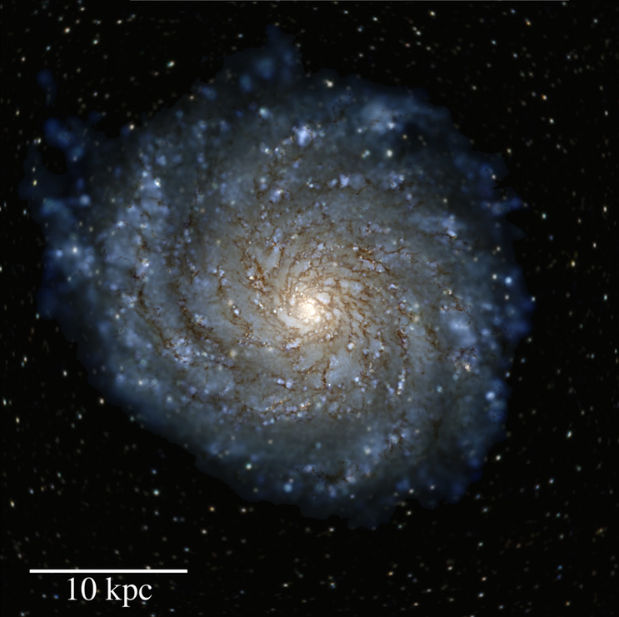
Motivations & Context
Massive stars change their environment significantly.
  Outflows
  Winds
  Ionizing radiation
  Supernovae
Galaxy formation and evolution simulations have trouble recreating realistic galaxies.
Phil Hopkins’ Research Group
Romeo (m12 ELVIS Local Group analogue)

Slide 3
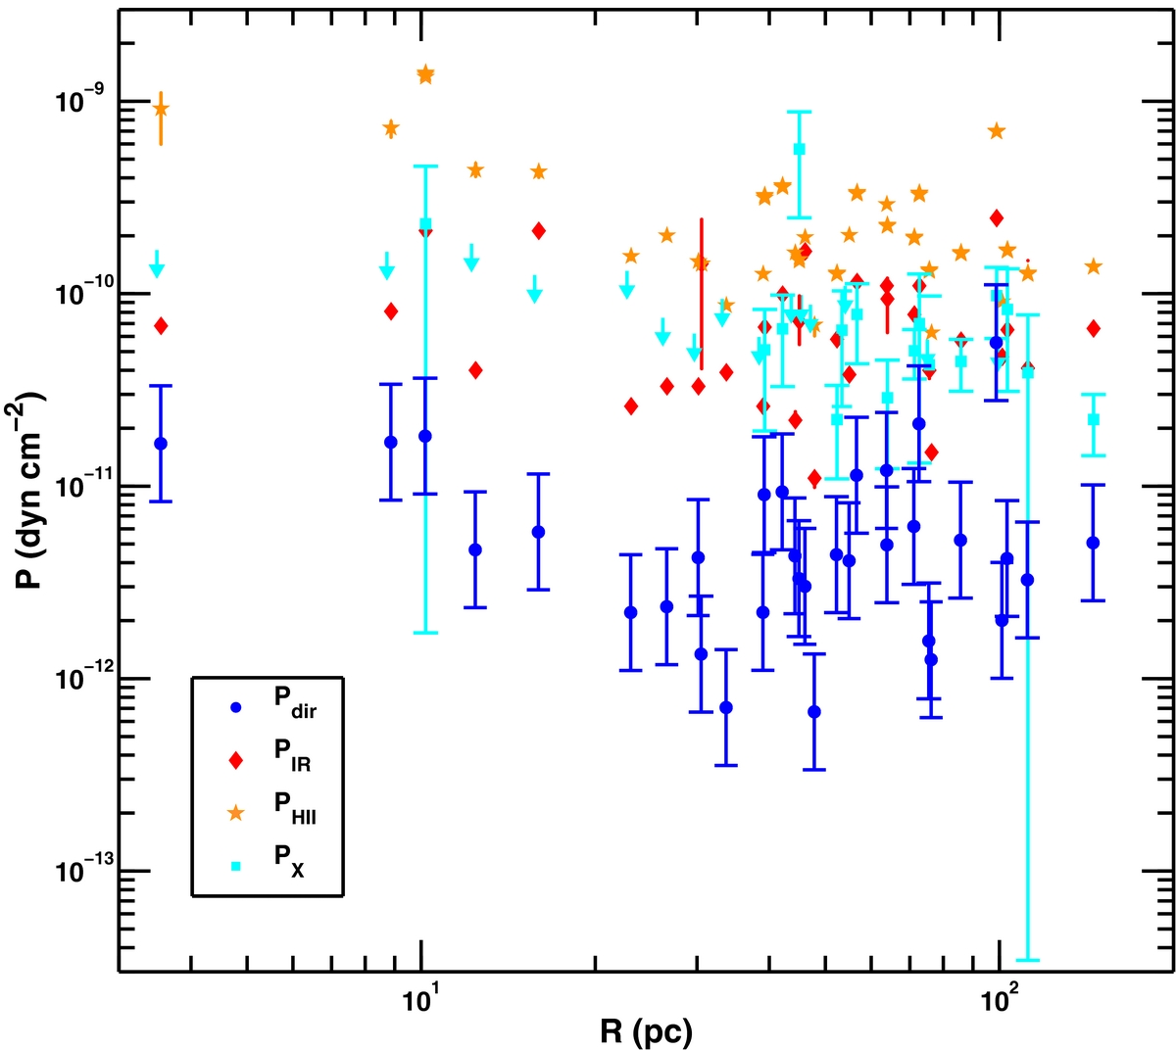
Motivations & Context
Growing number of studies focusing on feedback in the last two decades.
  Lopez et al. 2011
  Lopez et al. 2014
  Many more
Feedback mechanisms:
  Direct radiation
  Dust-processed radiation
  Ionized gas
  Stellar winds
Lopez et al. 2014

Slide 4
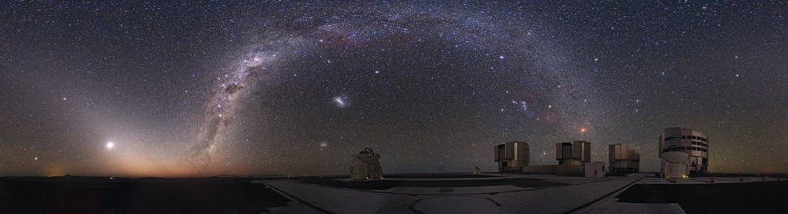
MUSE – Multi Unit Spectroscopic Explorer
Mounted on the VLT
Pixel scale of 0.2 arcsec/pixel
Resolving power of 1770 to 3590 over range of 4750 A – 9350 A.
Credit:ESO/Y. Beletsky

Slide 5
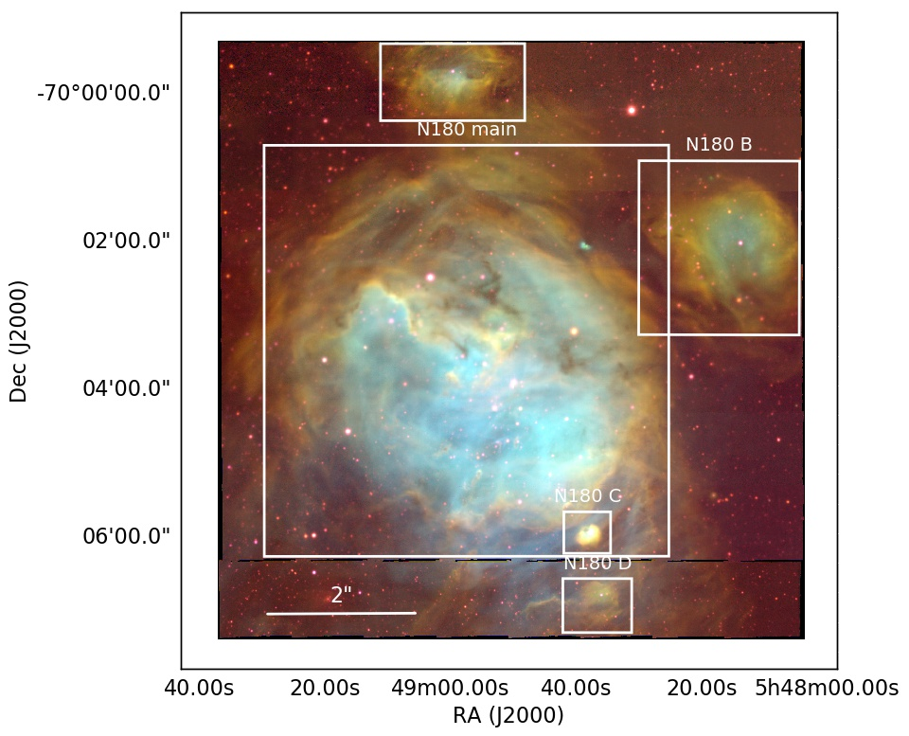
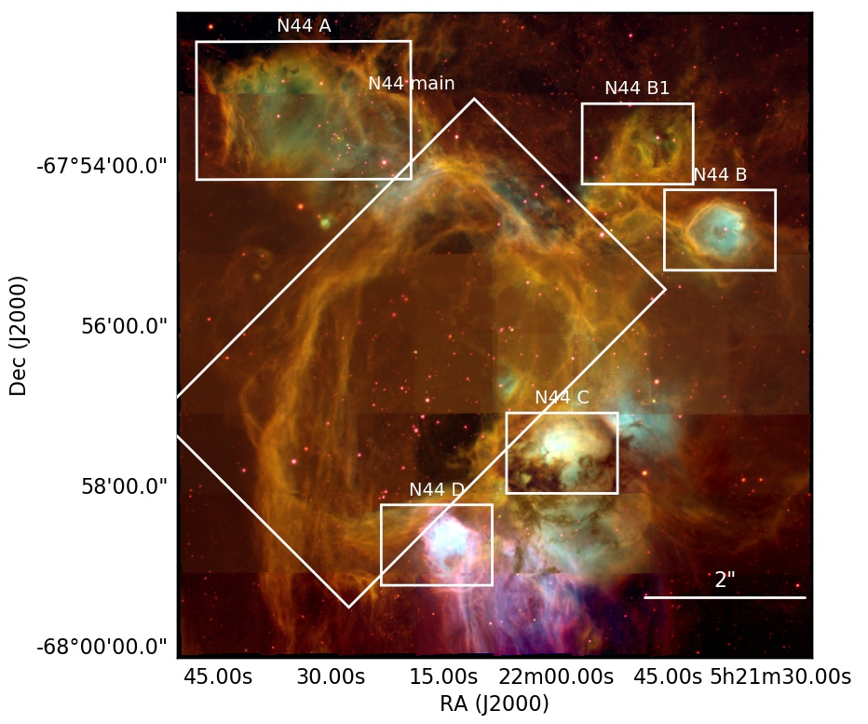
N44 & N180

Slide 6
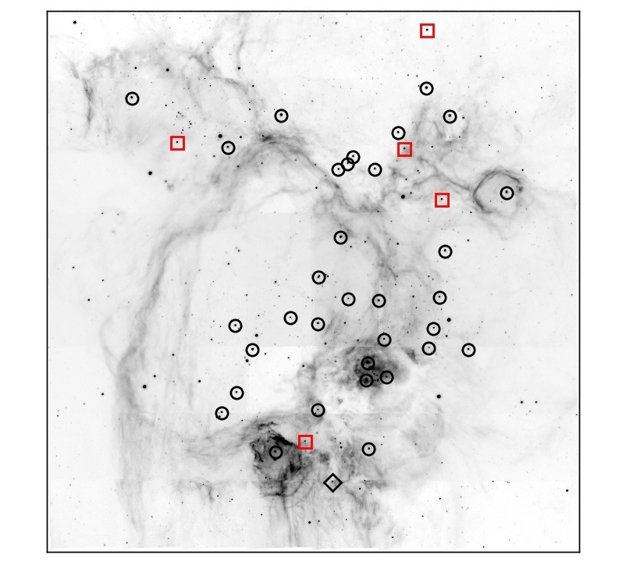
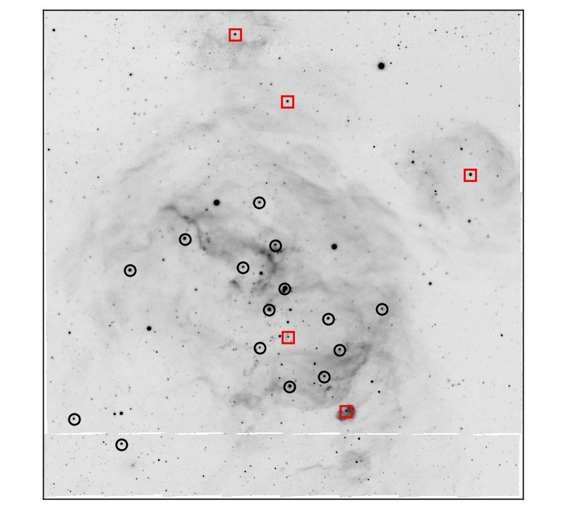
O-star Census
10 new O-stars
  5 per region
Reclassified 1 previously identified O star as a B star for each region.
N44
N180

Slide 7
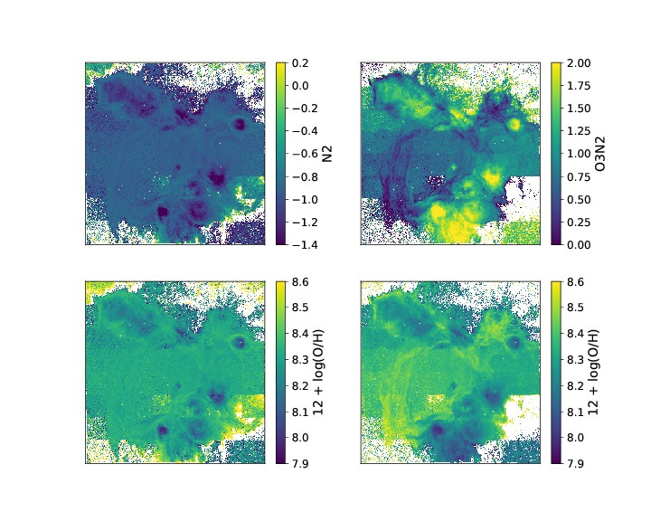
Metallicity Indicators
Use strong-line method to calculate the oxygen abundances.
N44

Slide 8
Feedback Pressures
Direct radiation pressure
Ionized gas pressure
Stellar wind pressure
No dust-processed radiation pressure
  They have no IR data

Slide 9
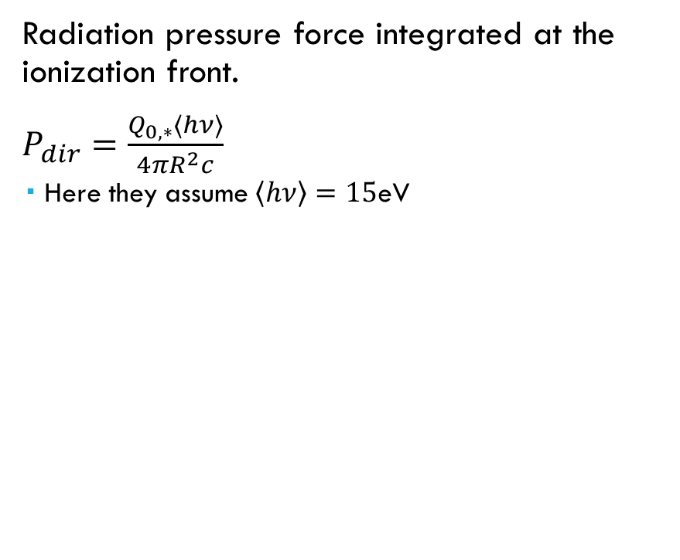
Direct Radiation Pressure
Radiation pressure force integrated at the ionization front.
$P_{dir}=\frac{Q_{0,∗}\left\langle hν\right\rangle }{4πR^{2}c}$
  Here they assume $\left\langle hν\right\rangle =15$eV
N44

Slide 10
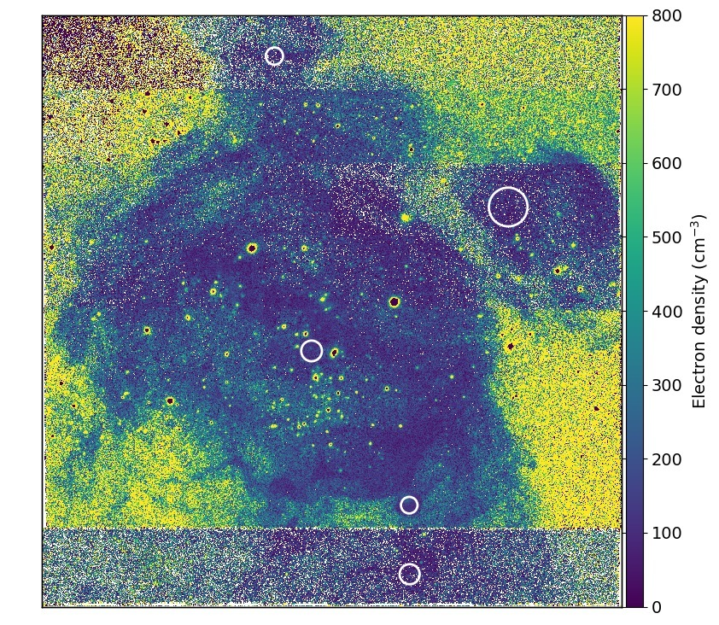
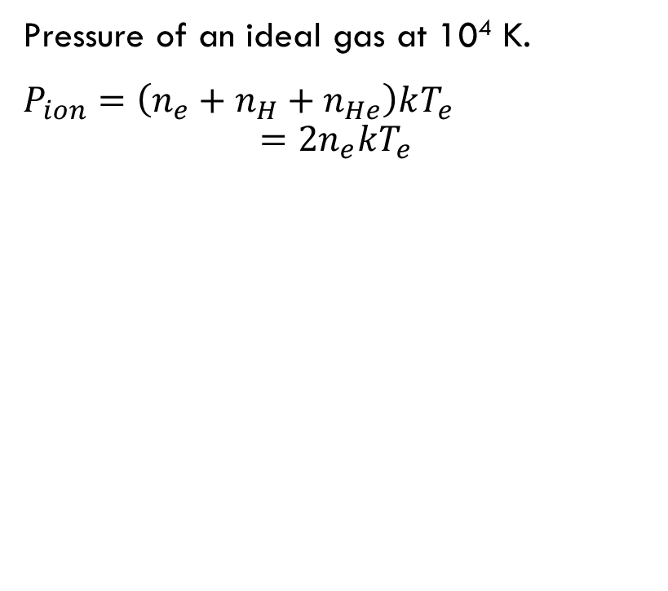
Ionized Gas Pressure
Pressure of an ideal gas at 10⁴ K.
$P_{ion}=\left(n_{e}+n_{H}+n_{He}\right)kT_{e}$
$=2n_{e}kT_{e}$
N180
Notes:
Calculated by the line ratio between two reddening-corrected Sulphur lines.

Slide 11
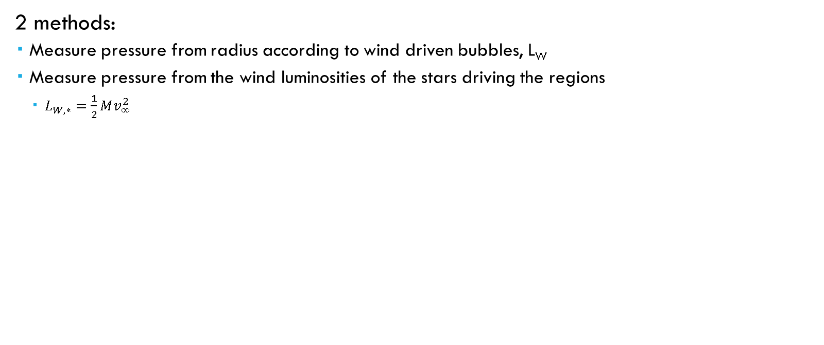
Stellar Wind Pressure
2 methods:
  Measure pressure from radius according to wind driven bubbles, L_{W}
  Measure pressure from the wind luminosities of the stars driving the regions
    $L_{W,∗}=\frac{1}{2}Mv_{∞}^{2}$

Slide 12
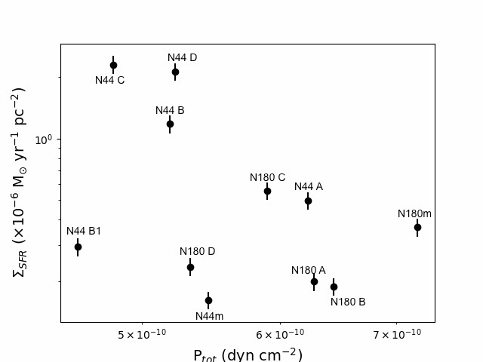
Star Formation Rate
Use the Kennicutt (1998) relation to calculate the SFR for each region.
Notes:
Upper right hand corner is empty because the feedback pressures set an upper limit to the SFR. More feedback less SF.

Slide 13
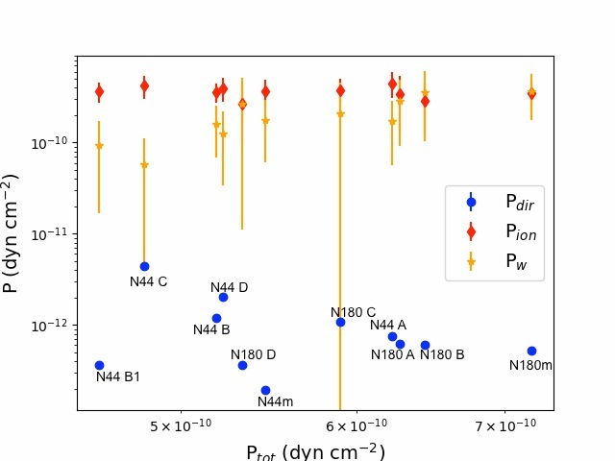
What’s Driving the Dynamics?
They find that ionized gas pressures generally drive the regions.
Direct radiation pressure is small.
Notes:
Wind pressures from the measured radius not from the calculated by stellar pop.

Slide 14
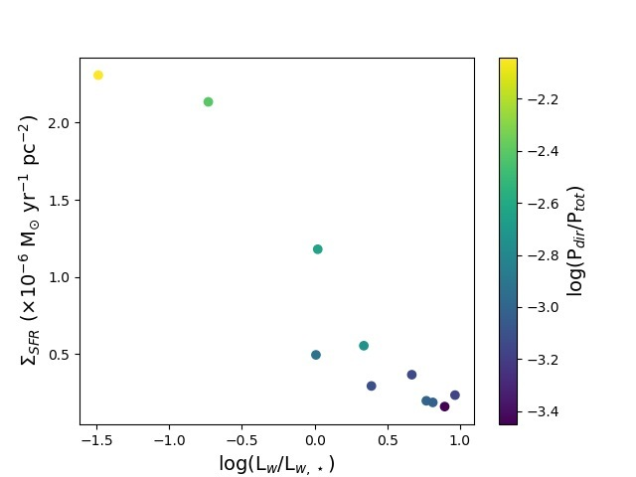
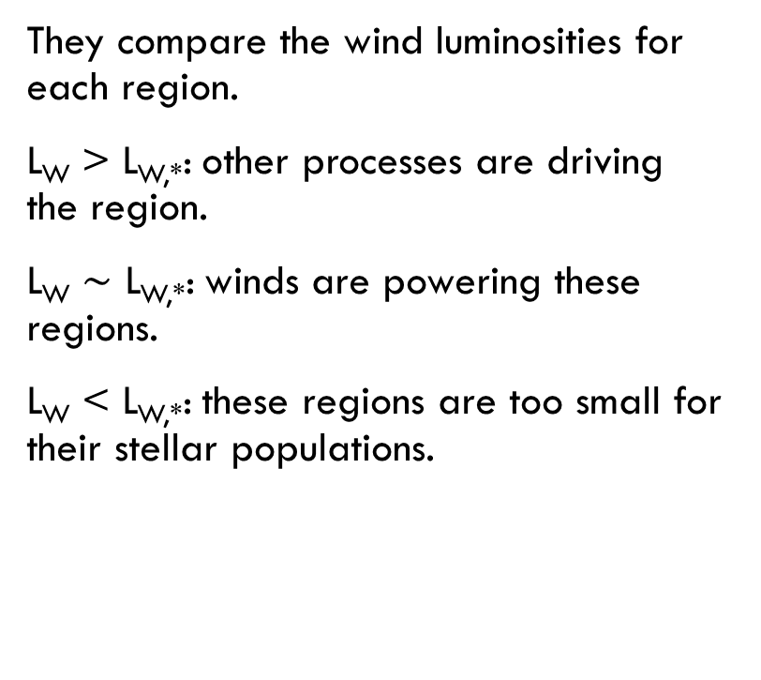
Wind Comparison
They compare the wind luminosities for each region.
L_{W} > L_{W,*}: other processes are driving the region.
L_{W} $∼$ L_{W,*}: winds are powering these regions.
L_{W} < L_{W,*}: these regions are too small for their stellar populations.

Slide 15
Their Conclusions
Feedback sets an upper limit for SFR.
Ionization pressure “generally dominates” these regions.
Some of the regions are too small compared to the radius they should have from their winds – expanding into dense material.

Slide 16
My Concerns
SFR – Kennicutt (1998) assumes a population of HII regions of different ages…
Direct radiation pressure makes assumptions about the gas that’s being pushed.
Wind luminosities – contradict their pressure calculations.
No mention of X-rays.

Slide 17
My Concerns
SFR – Kennicutt (1998) assumes a population of HII regions of different ages…
Direct radiation pressure makes assumptions about the gas that’s being pushed.
Wind luminosities – contradict their pressure calculations.
No mention of X-rays.

Slide 18
My Concerns
SFR – Kennicutt (1998) assumes a population of HII regions of different ages…
Direct radiation pressure makes assumptions about the gas that’s being pushed.
Wind luminosities – contradict their pressure calculations.
No mention of X-rays.

Slide 19
My Concerns
SFR – Kennicutt (1998) assumes a population of HII regions of different ages…
Direct radiation pressure makes assumptions about the gas that’s being pushed.
Wind luminosities – contradict their pressure calculations.
No mention of X-rays.

Slide 20
My Concerns
SFR – Kennicutt (1998) assumes a population of HII regions of different ages…
Direct radiation pressure makes assumptions about the gas that’s being pushed.
Wind luminosities – contradict their pressure calculations.
No mention of X-rays.

Slide 21
My Conclusions
If we plot these regions as P vs R we can put them in context with other measurements.

Slide 22
My Conclusions
If we plot these regions as P vs R we can put them in context with other measurements.
  Lopez et al. 2014

Slide 23
My Conclusions
If we plot these regions as P vs R we can put them in context with other measurements.
  Lopez et al. 2014
Generally, the new measurements of feedback pressures agree with previous and in progress work.

